Slide 1
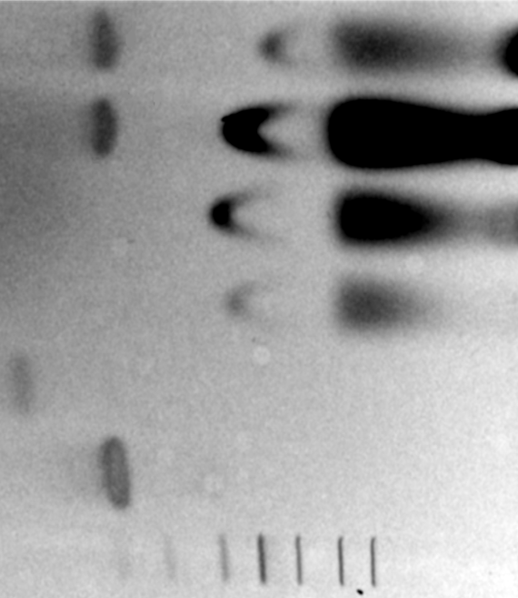
siRNA@NU-1000 w/ enzyme
siRNA@NU-1000
NU-1000 MOF w/ enzyme
NU-1000 MOF
Naked siRNA w/ enzyme
Naked siRNA
dsRNA ladder
21 nt
80 nt

